Slide 1
CREDIT RISK MANAGEMENT
Credit Culture & Disciplined Lending
Delivered by
Harlan Hill
Hill Financial Education, Inc.

Slide 2
Introduction

Slide 3
Prior Experience
While changing jobs 1 time, these were my employers:
First National Bank – Dallas
InterFirst Bank Dallas
FirstRepublic Bank Dallas
The Federal Deposit Insurance Corporation
NCNB Texas National Bank
MBank Dallas
The Federal Deposit Insurance Corporation
Bank One Corporation
In each instance the damage was already done!
Other experience: SMU and Ohio State, adjunct professor

Slide 5
Broad brushstroke of today’s webinar
The credit world can often be a confusing place. Pressure to book loans and maintain credit quality can create uncertainty about bank lending objectives.
Creating an effective credit culture can eliminate much of this uncertainty. By approaching target lending markets in a disciplined and focused manner, banks can better achieve consistent performance through credit and economic cycles.

Slide 6
What do we have to worry about these days?
Pandemic leftovers – and, who knows?
High oil prices
High inflation
Rising interest rates
Higher Cap Rates
Whatever
In other words, not a lot to worry about, keep your cultural compass pointed in the right direction

Slide 7
Topics
Credit culture
Concept of disciplined lending
Guiding principles
Skidding out of your lane (examples)

Slide 8
Credit Culture

Slide 9
What is credit culture?
Credit culture is the informal bond and set of norms that unites the organization into a cohesive and disciplined group of people extending credit into a chosen marketplace.
In other words: “The way we do things around here”

Slide 10
Features of a credit culture
Generally invisible
All encompassing
Learned and transmitted to succeeding generations
Resistant to change

Slide 11
Features of a credit culture (cont’d)
It’s easy to take credit culture for granted
Without a sound credit culture, the credit foundation of the bank is weakened
The best credit culture creates an atmosphere where everyone knows the goals and objectives of the organization
Bank leaders are trained to know the culture, and mature into the organizational structure with these principles in mind

Slide 12
Facets of culture
It starts at the top of the house
Not only setting policy and procedures, but the cultural feel of the organization
This is often transmitted as part of management’s attitude and approach to risk in the organization

Slide 13
Approach credit as a ‘business person’
You are a ‘business person” who coincidentally happens to be in the business of lending money and managing a portfolio
Businesses we lend to adhere to certain risk taking guidelines, we in the banking business need to do the same

Slide 14
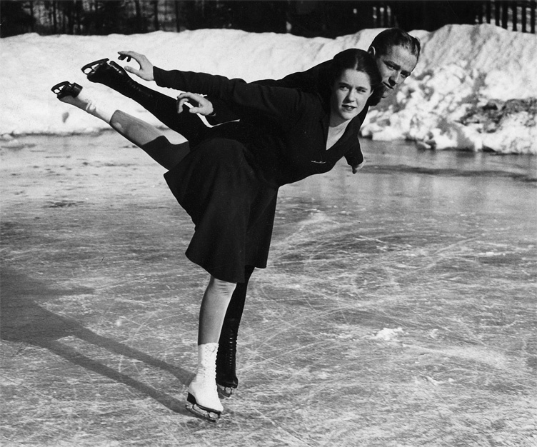
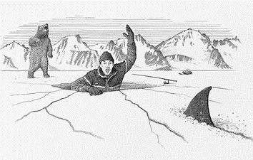
Judging your culture
Is everyone in synch?
Or are you skating too close to the edge?

Slide 15
We’ll peel off one layer today
Credit culture would take a long time to explore thoroughly, more time than we have today
Today, we’re only going to discuss one facet of the culture:
Discipline
Which implies an organization with Disciples

Slide 16
Endings: What do we make, what do we lose?
In 2019, the ROAA for U.S. banks was 1.34 percent
When a charge off occurs of, let’s say, $100,000
$100,000 ÷ .0134 = $7.4 Million in new loans needed to replace the earnings stream

Slide 17
Polling Question 1

Slide 18
Disciplined Lending

Slide 19
Disciplined Lending
Disciplined (adjective): “Showing a controlled form of behavior or way of working”
Applied to our business: Showing the willpower to control the bank’s credit behavior in extraordinary times

Slide 20
Sometimes it only takes one to fall out of line
Rogue lenders can create an avalanche of:
Profits
Problems

Slide 21
Undisciplined Lending
Undisciplined (adjective): “Lacking in discipline; uncontrolled in behavior or manner”
Applied to our business: Not adhering to principles that can make a difference to the bank’s returns
This is where the real trouble starts

Slide 22
Everyone starts out “disciplined”
“We won’t make the mistake of putting all of our eggs in that oil and gas basket”
“We won’t make the mistake of putting all of our eggs in that ____?______ basket”
“No way we’ll make those non-recourse, unstructured real estate loans again”
“We’ve learned our lesson on those highly levered loan transactions”
“No more of these housing development land loans for us, we know better now”

Slide 23
A much smarter person than me once said
“The spirit indeed is willing, but the flesh is weak.”

Slide 24
How does it start?
Good Economic Times
Companies making money
Portfolio growing
Risk ratings reflect these good times
Press the line to make more loans

Slide 25
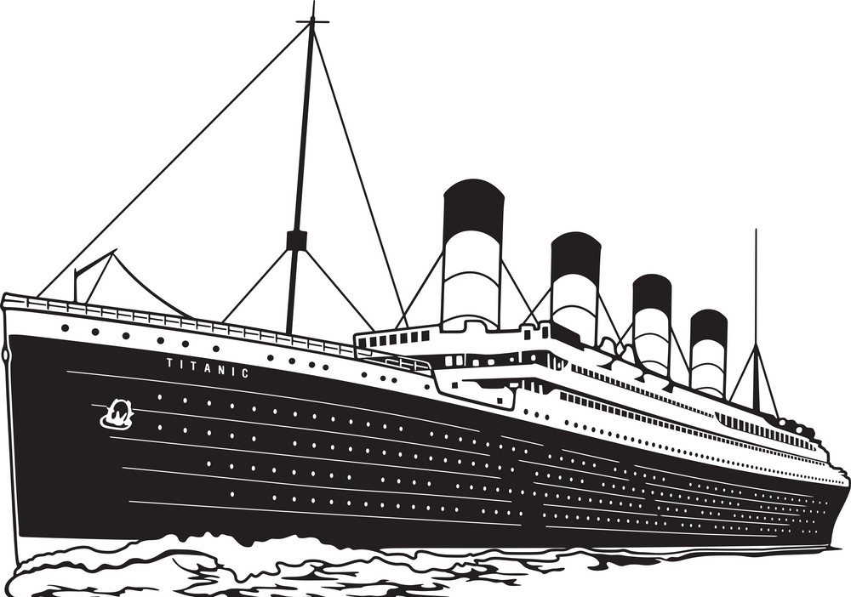
How does it end?
In the movie Titanic…
No matter what anyone says, we all know there was a ton of room on that floating door for both Jack and Rose to wait until help arrived
Great movie, bad ending

Slide 26
Undisciplined credit behavior often has a bad ending
Bank failures in the US
Year | Number of failures
2008 | 25
2009 | 140
2010 | 157
2011 | 92
2012 | 51

Slide 27
Now we’re in the clear…right? or are we? Is it the cycle or market discipline

Slide 28
Polling Question 2

Slide 29
Disciplined Lending: The Cycle

Slide 30
The Business Cycle
Upswing
Growth
Mature
Downturn
Time
Notes:
Note: This slide is animated. Click the mouse to have the graph drawn.
The grandfather of concepts for predicting the probable course of an industry is the product lifecycle. The hypothesis is that an industry will pass through a number of phases or stages – embryonic, growth, maturity and decline. The industry will follow an “S” curve because of the process of innovation and diffusion of new product.
The use of this hypothesis is to
To help predict future industry performance over the near term
To aid managers in creating strategy or, in the case of the bank, to analyze management’s strategy particularly in relation to its competitor group. At different points during the life cycle, different strategies and management capabilities are needed.
Right now we will only describe the cycles, not the strategies or management qualities.
Embryonic Industries
Characteristics - Small market size, few buyers, unproven product, technologically advanced products, few competitors.
Business Priority - Product introduction, R&D.
Financial Focus - Stop losses, liquidity, capital raising.
Banks are usually not involved in this stage of development.
Growth Industry
Characteristics - product acceptance, new buyers, new product lines, larger market size, new competitors, experienced management.
Business Priority - market, production, and distribution.
Financial Focus - working capital management, financing growth, equity issuance.
Banks begin to finance although probably not at beginning of growth cycle.
Mature Industry
Characteristics - market size stable, buyers have experience with and information about the product, consolidating, stable profits, improving quality, established capital sources.
Business Priority - Operating efficiencies or lowest cost producer. Building a brand to differentiate.
Financial Focus - decrease working capital costs, acquisitions, minimize business cycle risks, leveraging assets and returning capital to shareholders.
Declining Industries
Characteristics - decreasing market size, decline in number of buyers, rapid consolidations, losses, increasing number of substitutes.
Business Priorities - diversification, downsizing.
Financial Focus - balance sheet management.
However, the product life cycle theory has criticism (not only from Porter but others).
1- It is often unclear exactly at which stage of the life cycle an industry is in because the duration of the life cycle varies from industry to industry. This diminishes the usefulness of this hypothesis as a planning tool. And makes it difficult for bankers to exactly predict where the industry will go next.
2- Many industries do not go through an S curve at all. Or become re-vitalized due to changes in buyer preferences or new innovations.
We discussed declining industries earlier and gave examples of industries that were in a decline during the 1970s; motorcycles, bicycles, leather and railroads. Yet all four of the industries have experienced a resurgence. Motorcycles, bicycles and leather have all experienced a resurgence due to changing consumer preferences. Motorcycles saw a resurgence of the “yuppie biker” and the high speed motorcycles (ala Miami Vice in the 1980s). Bicycles have resurged as means to exercise and with the popularity of mountain biking. Leather was not replaced by synthetic materials – in fact if you look back, synthetics were more of a short term trend. The railroad industry due to structural changes in trucking and railroads.
3 – Individual companies can affect the shape of the curve through product innovations and repositioning. If managers assume the life cycle is a given, they may create a self-fulfilling prophesy by failing to innovate or reposition.
4- The nature of competition associated with each stage of the cycle is different for different industries. Divergent patters call into serious question the strategic implications of the life cycle. This means that as a planning tool assuming an industry will go through an S curve is a poor assumption.
Primary Issue: Industries do no change in a piecemeal fashion because an industry is an inter-related system. There is no one way industries evolve; therefore, a single model for evolution such as the product life cycle is not adequate. (Porter actually says “rejected”).

Slide 31
The Business Cycle
When does the risky lending tend to occur?
Upswing
Growth
Mature
Downturn
Time
Notes:
Note: This slide is animated. Click the mouse to have the graph drawn.
The grandfather of concepts for predicting the probable course of an industry is the product lifecycle. The hypothesis is that an industry will pass through a number of phases or stages – embryonic, growth, maturity and decline. The industry will follow an “S” curve because of the process of innovation and diffusion of new product.
The use of this hypothesis is to
To help predict future industry performance over the near term
To aid managers in creating strategy or, in the case of the bank, to analyze management’s strategy particularly in relation to its competitor group. At different points during the life cycle, different strategies and management capabilities are needed.
Right now we will only describe the cycles, not the strategies or management qualities.
Embryonic Industries
Characteristics - Small market size, few buyers, unproven product, technologically advanced products, few competitors.
Business Priority - Product introduction, R&D.
Financial Focus - Stop losses, liquidity, capital raising.
Banks are usually not involved in this stage of development.
Growth Industry
Characteristics - product acceptance, new buyers, new product lines, larger market size, new competitors, experienced management.
Business Priority - market, production, and distribution.
Financial Focus - working capital management, financing growth, equity issuance.
Banks begin to finance although probably not at beginning of growth cycle.
Mature Industry
Characteristics - market size stable, buyers have experience with and information about the product, consolidating, stable profits, improving quality, established capital sources.
Business Priority - Operating efficiencies or lowest cost producer. Building a brand to differentiate.
Financial Focus - decrease working capital costs, acquisitions, minimize business cycle risks, leveraging assets and returning capital to shareholders.
Declining Industries
Characteristics - decreasing market size, decline in number of buyers, rapid consolidations, losses, increasing number of substitutes.
Business Priorities - diversification, downsizing.
Financial Focus - balance sheet management.
However, the product life cycle theory has criticism (not only from Porter but others).
1- It is often unclear exactly at which stage of the life cycle an industry is in because the duration of the life cycle varies from industry to industry. This diminishes the usefulness of this hypothesis as a planning tool. And makes it difficult for bankers to exactly predict where the industry will go next.
2- Many industries do not go through an S curve at all. Or become re-vitalized due to changes in buyer preferences or new innovations.
We discussed declining industries earlier and gave examples of industries that were in a decline during the 1970s; motorcycles, bicycles, leather and railroads. Yet all four of the industries have experienced a resurgence. Motorcycles, bicycles and leather have all experienced a resurgence due to changing consumer preferences. Motorcycles saw a resurgence of the “yuppie biker” and the high speed motorcycles (ala Miami Vice in the 1980s). Bicycles have resurged as means to exercise and with the popularity of mountain biking. Leather was not replaced by synthetic materials – in fact if you look back, synthetics were more of a short term trend. The railroad industry due to structural changes in trucking and railroads.
3 – Individual companies can affect the shape of the curve through product innovations and repositioning. If managers assume the life cycle is a given, they may create a self-fulfilling prophesy by failing to innovate or reposition.
4- The nature of competition associated with each stage of the cycle is different for different industries. Divergent patters call into serious question the strategic implications of the life cycle. This means that as a planning tool assuming an industry will go through an S curve is a poor assumption.
Primary Issue: Industries do no change in a piecemeal fashion because an industry is an inter-related system. There is no one way industries evolve; therefore, a single model for evolution such as the product life cycle is not adequate. (Porter actually says “rejected”).

Slide 32
Tension is created
Tug of war between the sales side and the credit side
Both sides are right, in their own way. How?
Loan Officer: We’re paid to book loans, right? Certainly!
Credit Officer: We’re paid to maintain portfolio credit quality, right? Certainly!

Slide 33
The tension: the RM Hat vs. the Credit Hat
Booking loans is what we do
Booking good solid loans within our credit strike zone is what we do
If you’re not taking any risk, you won’t get any returns for the bank
At a 1.5% ROA we have to get this right almost all of the time to survive
If we pass on this loan, and it turns out OK for a competitor, who do I get to fire?
If we book this loan and it fails, who do I get to fire?

Slide 34
There’s always tension
But if one side takes too much advantage the rope will break
And you’ve lost the artful balance of successfully managing the bank’s risk profile

Slide 35
The Business Cycle and the Band of Discipline
Upswing
Growth
Mature
Downturn
Staying Disciplined through the Business Cycle
Time
Notes:
Note: This slide is animated. Click the mouse to have the graph drawn.
The grandfather of concepts for predicting the probable course of an industry is the product lifecycle. The hypothesis is that an industry will pass through a number of phases or stages – embryonic, growth, maturity and decline. The industry will follow an “S” curve because of the process of innovation and diffusion of new product.
The use of this hypothesis is to
To help predict future industry performance over the near term
To aid managers in creating strategy or, in the case of the bank, to analyze management’s strategy particularly in relation to its competitor group. At different points during the life cycle, different strategies and management capabilities are needed.
Right now we will only describe the cycles, not the strategies or management qualities.
Embryonic Industries
Characteristics - Small market size, few buyers, unproven product, technologically advanced products, few competitors.
Business Priority - Product introduction, R&D.
Financial Focus - Stop losses, liquidity, capital raising.
Banks are usually not involved in this stage of development.
Growth Industry
Characteristics - product acceptance, new buyers, new product lines, larger market size, new competitors, experienced management.
Business Priority - market, production, and distribution.
Financial Focus - working capital management, financing growth, equity issuance.
Banks begin to finance although probably not at beginning of growth cycle.
Mature Industry
Characteristics - market size stable, buyers have experience with and information about the product, consolidating, stable profits, improving quality, established capital sources.
Business Priority - Operating efficiencies or lowest cost producer. Building a brand to differentiate.
Financial Focus - decrease working capital costs, acquisitions, minimize business cycle risks, leveraging assets and returning capital to shareholders.
Declining Industries
Characteristics - decreasing market size, decline in number of buyers, rapid consolidations, losses, increasing number of substitutes.
Business Priorities - diversification, downsizing.
Financial Focus - balance sheet management.
However, the product life cycle theory has criticism (not only from Porter but others).
1- It is often unclear exactly at which stage of the life cycle an industry is in because the duration of the life cycle varies from industry to industry. This diminishes the usefulness of this hypothesis as a planning tool. And makes it difficult for bankers to exactly predict where the industry will go next.
2- Many industries do not go through an S curve at all. Or become re-vitalized due to changes in buyer preferences or new innovations.
We discussed declining industries earlier and gave examples of industries that were in a decline during the 1970s; motorcycles, bicycles, leather and railroads. Yet all four of the industries have experienced a resurgence. Motorcycles, bicycles and leather have all experienced a resurgence due to changing consumer preferences. Motorcycles saw a resurgence of the “yuppie biker” and the high speed motorcycles (ala Miami Vice in the 1980s). Bicycles have resurged as means to exercise and with the popularity of mountain biking. Leather was not replaced by synthetic materials – in fact if you look back, synthetics were more of a short term trend. The railroad industry due to structural changes in trucking and railroads.
3 – Individual companies can affect the shape of the curve through product innovations and repositioning. If managers assume the life cycle is a given, they may create a self-fulfilling prophesy by failing to innovate or reposition.
4- The nature of competition associated with each stage of the cycle is different for different industries. Divergent patters call into serious question the strategic implications of the life cycle. This means that as a planning tool assuming an industry will go through an S curve is a poor assumption.
Primary Issue: Industries do no change in a piecemeal fashion because an industry is an inter-related system. There is no one way industries evolve; therefore, a single model for evolution such as the product life cycle is not adequate. (Porter actually says “rejected”).

Slide 36
How do you know if you’re outside the band?
A great invention: You put a cold drink inside and the drink stays cold. You put a hot drink inside and it stays hot. How does it know?
How do you know if your bank is disciplined?
Just like a Thermos – You know

Slide 37
In-Class Thought
Assignment: Discuss your bank’s approach to disciplined lending. Like a Thermos, what do you think?
Time: 1 minute
Answer | Questions
1 | Do you think your bank does a good job of practicing credit risk discipline across the board? HIGHLY disciplined
2 | Do you think your bank does a mediocre job of practicing credit risk discipline across the board? KIND OF disciplined
3 | Do you think your bank does a good job of practicing credit risk discipline in a few areas? UNDISCIPLINED

Slide 38
Polling Question 3

Slide 39
Guiding Principles

Slide 40
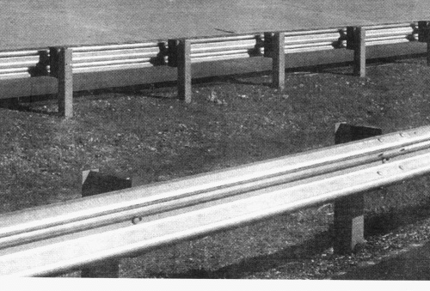
One way to stay where you want to be
Develop your own guardrails
Do it with all constituencies involved

Slide 41
Staying in the band of discipline
Easier said than done, but an idea
Guiding principles setting forth, for all to know, who you are and what you do
And, perhaps of equal weight, who you’re not and what you don’t do

Slide 42
How to do it right?
Get buy in from “both sides of the aisle”
The sales side will benefit from an understanding of what is expected of the, instead of getting a conflicting message
The credit side benefits from being shown opportunities that fit the credit risk appetite of the institution

Slide 43
Guiding principles for staying disciplined: Examples
We view cash flow from earnings as our pre-eminent source of repayment
We value integrity in our borrowers and diligently investigate past behavior
We only lend to businesses with a significant monetary and psychological investment on the part of the business owner
We want to target the right customers for our market and risk/reward profile
We know when to say “no” to a transaction – Example Bank can survive a “lost” bad loan better than a “won” bad loan
We will be candid with our customers and colleagues regarding business events and changes in risk profiles

Slide 44
Now, not how do you know, but what do you know?
Stick to what you know
Avoid what you don’t know

Slide 45
Judging your culture
Does it come from the top?
Is there communication from the President/CEO/CCO, all 3, or equivalent?
Do you perceive everyone knows what the culture is?
Is everyone practicing it?

Slide 46
Polling Question 4

Slide 47
Lack of Market Discipline (examples)

Slide 48
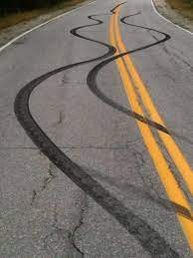
Example 1: Skidding out of your lane
Bank CEO: “Are you being too conservative here?”
Bank CCO: “I thought that was my job”
Bank CEO: “No, that isn’t your job. We’re in the credit risk management business, not the risk free business. We should be taking appropriate credit risk commensurate with our values”

Slide 49
Example 2: Skidding out of your lane
While interviewing with the head of Middle Market banking, the standard “post college” interview with a smorgasbord of departments within the bank, a very young interviewee asks:
Interviewee: “Well, middle market is a great, really fun place to be, and I think you’ll grow the business a lot. But I’m really interested in oil and gas finance”
Response from the head of Middle Market: “Oh, don’t worry, we find ways to do lots of the oil and gas deals in our middle market department”

Slide 50
Example 3: Skidding out of your lane
From a senior manager to a credit approval officer at a $500 million asset bank:
“I don’t understand this deal fully, but we’ve got to do the deal or the relationship will be lost”
What would be your reaction to this statement if you were the credit approval officer? What would you say?

Slide 51
Conclusion

Slide 52
Key points to remember!
Credit Culture
Guiding Principles
Market Related Success
A credit culture is cultivated when every person knows what the objectives and goals of the bank are
A disciplined approach to the market will be rewarded in the long run
An ideal credit culture reflects these objectives and goals in a formalized document

Slide 53
Conclusion: A sound credit culture
Every lending entity usually develops practices for credit risk management
This framework can be in the form of a sound credit culture
It is imperative to keep in mind that without a sound credit culture, credit risk cannot be managed effectively
A more formal means of establishing this framework is the bank’s Credit Culture – Attitude and Statement - the specific means by which practices and procedures are espoused and enforced

Slide 54
Questions?

Slide 55
Alert: May 20, 2022 at 9:00 AM Pacific Conversation with Credit Leaders in the Know
PCBS sponsoring a Chief Credit Officer Forum
I’ll be interviewing:
Michael Morris, CCO, Zions Bancorp
Jill Rice, CCC, Banner Bank
Mike Short, CCO, CoBank
I’d very much like you to submit some questions to us at PCBS to have these CCO’s address during the forum:
Harlan@HILLFED.net

Slide 56
My contact information
LinkedIn: Harlan Hill | Email: Harlan@HILLFED.net | Website: Paragon-Hill.com

